Slide 1
Do Now
Answer these multiple-choice questions
The correct formula for dinitrogen monoxide is: a) NO b) N₂O₂ c) N₂O₁ d) N₂O
The correct name for H₂S is: a) dihydrogen sulfur b) dihydrogen sulfide c) dihydrogen monosulfide d) hydrogen sulfide
3. What type of compound is Na₂SO₄ ?? a) Covalent
b) Metallic c) Ionic b) Precipitate
4. How many atoms are present in KNO₃? a) 3 b) 5 c) 4 d) 2
5. Which is not a sign of a chemical change? a) change of colour
b) change in size c) gas produced d) heat produced
6. Which does not involve a physical change? a) Moldy bread
b) Rain falling c) Steam from a kettle d) Mixing sand and water

Slide 2
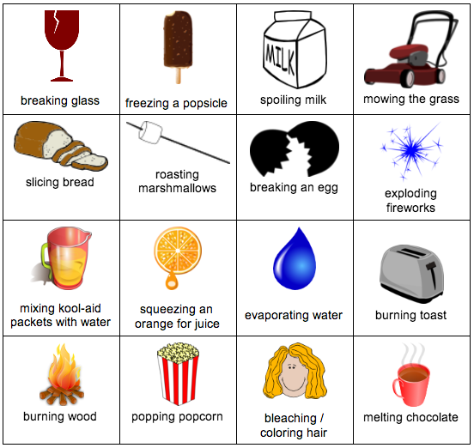
Daily Review
Chemical change: - New product/s are formed - Usually, can’t be reversed
Physical change: - Particles in the substance don’t change
- Usually, reversible
For each action in the table, decide if it is a physical or chemical change...
PHYSICAL
PHYSICAL
CHEMICAL
PHYSICAL
PHYSICAL
CHEMICAL
PHYSICAL
CHEMICAL
PHYSICAL
PHYSICAL
PHYSICAL
CHEMICAL
CHEMICAL
CHEMICAL
CHEMICAL
PHYSICAL

Slide 3
Physical and Chemical Properties Year 8 Science

Slide 4
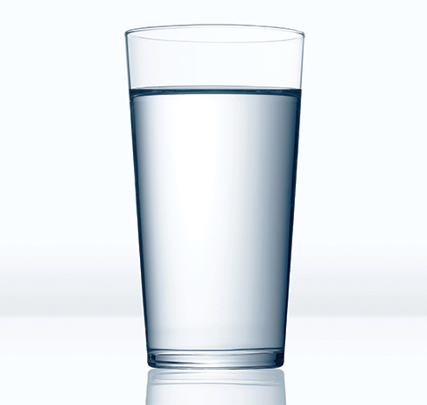
Learning Objectives
CFU
What two types of properties are we learning about?
Define and list physical properties and chemical properties.
Identify a property as chemical or physical.
Activate Prior Knowledge
You find a container filled with a mysterious liquid on a bench. If you had every chemical and piece of equipment you wanted, how many of its properties could you discover? List them on your whiteboard.
(Example: you could use a measuring cylinder to find the volume of the water, or a ruler to find the height of the container.)
Vocabulary
property (noun) an attribute, quality, or characteristic

Slide 5
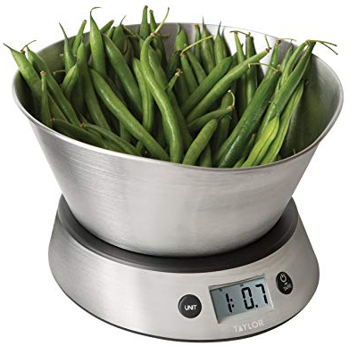
Concept Development
CFU 1
How can you tell if a property is a physical property?
Substances have physical properties and chemical properties.
A substance’s physical properties can be observed and measured either without changing it or through a physical change.
These include:
Colour and texture
Boiling and melting points
Density (mass / volume)
Solubility
CFU 2
What is one example of a physical property?
CFU 3
Which of the following are physical properties? Shape Flammability (whether or not something burns) How poisonous something is Lustre (shininess)
Vocabulary
physical change a change in shape or state that does not alter a substance’s particles

Slide 6
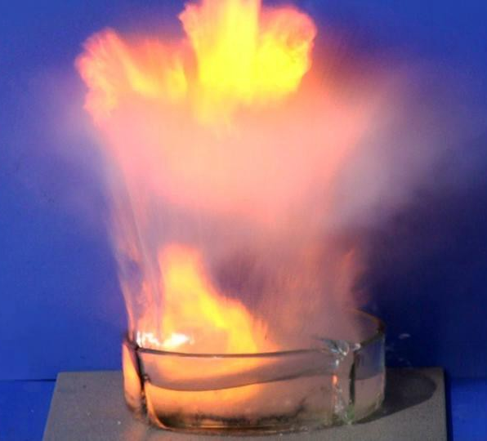
Concept Development
CFU 1
When can you observe a substance’s chemical properties?
Substances have physical properties and chemical properties.
A substance’s chemical properties define what it does in a chemical reaction. They can only be observed during chemical changes.
These include:
Whether a substance is stable or reactive
Flammability (whether or not something burns)
pH (how acidic something is)
Toxicity (how poisonous something is)
CFU 2
What is one example of a chemical property?
CFU 3
Carol says that magnetism is a chemical property. Is she correct? Why or why not?
Vocabulary
chemical change an irreversible change that causes a new substance to be formed
Sodium and other Group 1 metals are incredibly reactive!

Slide 7
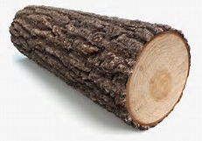
Skill Development / Guided Practice
CFU 1
How can you tell if a property is a chemical property?
Classifying Properties
How can the property be observed?
No change needed: physical property
Physical change: physical property
Chemical change / reaction: chemical property
What type of property is the colour of wood?
The colour of wood is a physical property, since no change is needed to observe it.
CFU 2
If no change is needed to observe a property, what type of property is it?
Vocabulary
physical change a change in shape or state that does not alter a substance’s particles chemical change an irreversible change that causes a new substance to be formed

Slide 8
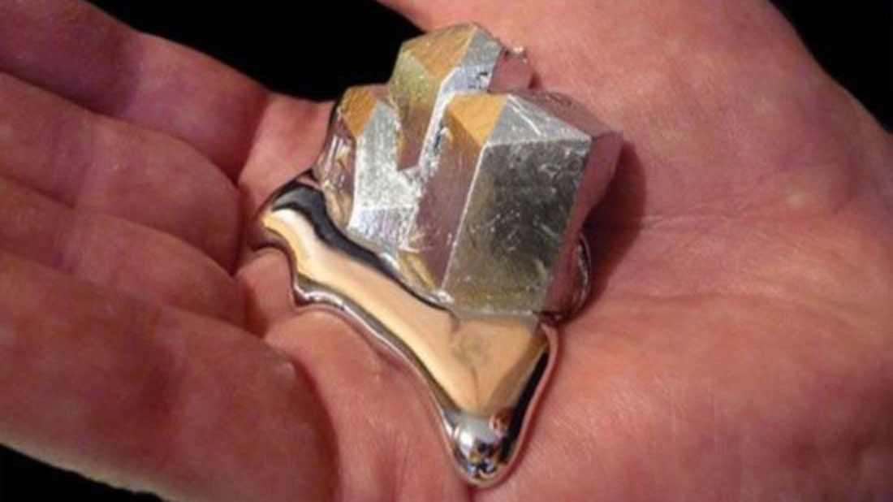
Skill Development / Guided Practice
CFU 1
Has the substance changed?
Classifying Properties
How can the property be observed?
No change needed: physical property
Physical change: physical property
Chemical change / reaction: chemical property
What type of property is the melting point of gallium?
The melting point of gallium is a physical property, since a physical change is needed to observe it.
CFU 2
What type of change has taken place?
Vocabulary
physical change a change in shape or state that does not alter a substance’s particles chemical change an irreversible change that causes a new substance to be formed

Slide 9
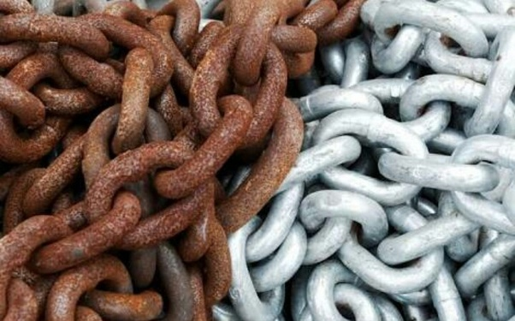
Skill Development / Guided Practice
CFU 1
Has the substance changed?
Classifying Properties
How can the property be observed?
No change needed: physical property
Physical change: physical property
Chemical change / reaction: chemical property
What type of property? Whether or not a metal rusts
Whether or not a metal rusts is a chemical property, since rusting is a chemical change.
CFU 2
What type of change has taken place?
Vocabulary
physical change a change in shape or state that does not alter a substance’s particles chemical change an irreversible change that causes a new substance to be formed

Slide 10

Skill Development / Guided Practice
CFU 1
Has the substance changed?
Classifying Properties
How can the property be observed?
No change needed: physical property
Physical change: physical property
Chemical change / reaction: chemical property
What type of property? The length of a bridge
CFU 2
What type of change has taken place?
Vocabulary
physical change a change in shape or state that does not alter a substance’s particles chemical change an irreversible change that causes a new substance to be formed

Slide 11
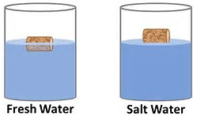
Skill Development / Guided Practice
CFU 1
Has the substance changed?
Classifying Properties
How can the property be observed?
No change needed: physical property
Physical change: physical property
Chemical change / reaction: chemical property
What type of property? The density of a cork
CFU 2
What type of change has taken place?
Vocabulary
physical change a change in shape or state that does not alter a substance’s particles chemical change an irreversible change that causes a new substance to be formed

Slide 12
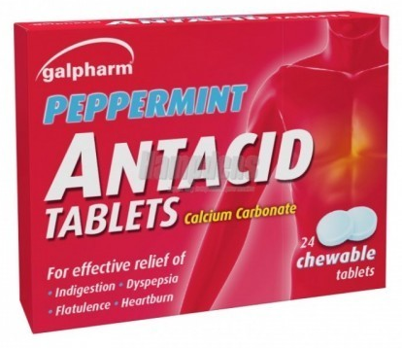
Skill Development / Guided Practice
CFU 1
Has the substance changed?
Classifying Properties
How can the property be observed?
No change needed: physical property
Physical change: physical property
Chemical change / reaction: chemical property
What type of property? How much an antacid tablet reacts with stomach acids
CFU 2
What type of change has taken place?
Vocabulary
physical change a change in shape or state that does not alter a substance’s particles chemical change an irreversible change that causes a new substance to be formed

Slide 13
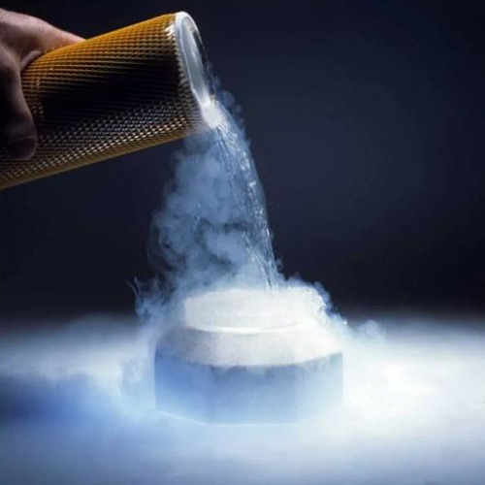
Skill Development / Guided Practice
CFU 1
Has the substance changed?
Classifying Properties
How can the property be observed?
No change needed: physical property
Physical change: physical property
Chemical change / reaction: chemical property
What type of property? The boiling point of nitrogen
CFU 2
What type of change has taken place?
Vocabulary
physical change a change in shape or state that does not alter a substance’s particles chemical change an irreversible change that causes a new substance to be formed

Slide 14
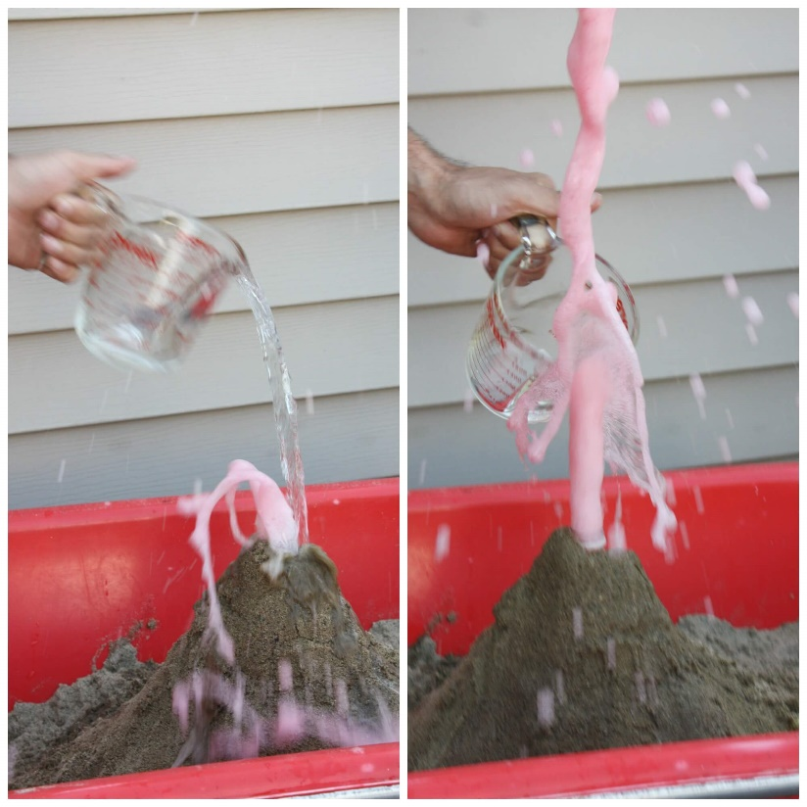
Skill Development / Guided Practice
CFU 1
Has the substance changed?
Classifying Properties
How can the property be observed?
No change needed: physical property
Physical change: physical property
Chemical change / reaction: chemical property
What type of property? Whether or not a substance forms a gas when mixed with vinegar
CFU 2
What type of change has taken place?
Vocabulary
physical change a change in shape or state that does not alter a substance’s particles chemical change an irreversible change that causes a new substance to be formed

Slide 15
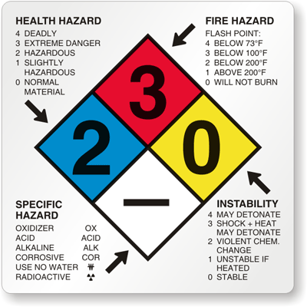
Relevance
Physical and chemical properties are used to identify substances in research, forensics, and a variety of other fields.
The physical and chemical properties of a substance determine what it is useful for – and how it might be dangerous!

Slide 16
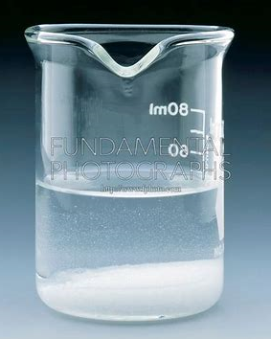

Skill Closure
Classifying Properties
How can the property be observed? No change needed: physical property Physical change: physical property Chemical change / reaction: chemical property
Using your own words, describe what a chemical property is.
Skill Closure
Is the solubility of sugar in water a physical or a chemical property? Explain your answer.
Vocabulary
physical change a change in shape or state that does not alter a substance’s particles chemical change an irreversible change that causes a new substance to be formed
Skill Closure
Hydrogen peroxide causes human hair to become bleached. What property causes this, and what kind of property is it?

